Slide 1
Bayesian Optimization and Structured Bayesian Optimization
instructions
Arpan Biswas, Research Assistant Professor, UT-ORII (Past: ORNL)
3rd March 2024, APS March Meeting 2024 Workshop Tutorial
Session: Data Science for Physicists II

Slide 2
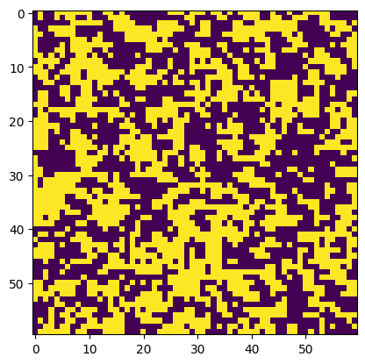
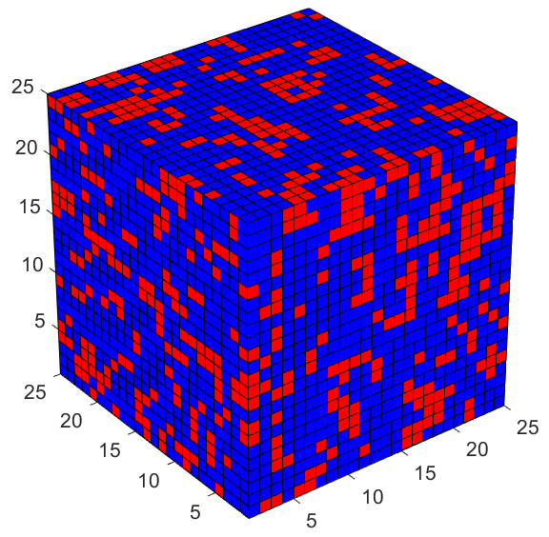
Problem Statement
60x60 Ising model
Classical Physics model
Objective
To learn phase transition at the ferromagnetic region over exploring 60x60 lattice size
Time for each simulation is ~ 8 mins
Model of Interest: Square Model
Problem Statement
Maximize Heat Capacity
Parameter space: Spin-spin interaction
Challenges
Can we do exhaustive search ?
Or any naïve approach like random grid search ?
How about gradient based?
How about evolutionary algorithm like GA?
Motivation
How about adaptive search? E.g. Bayesian optimization
1

Slide 3


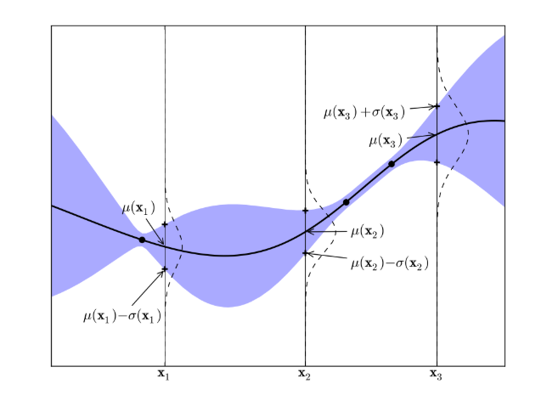
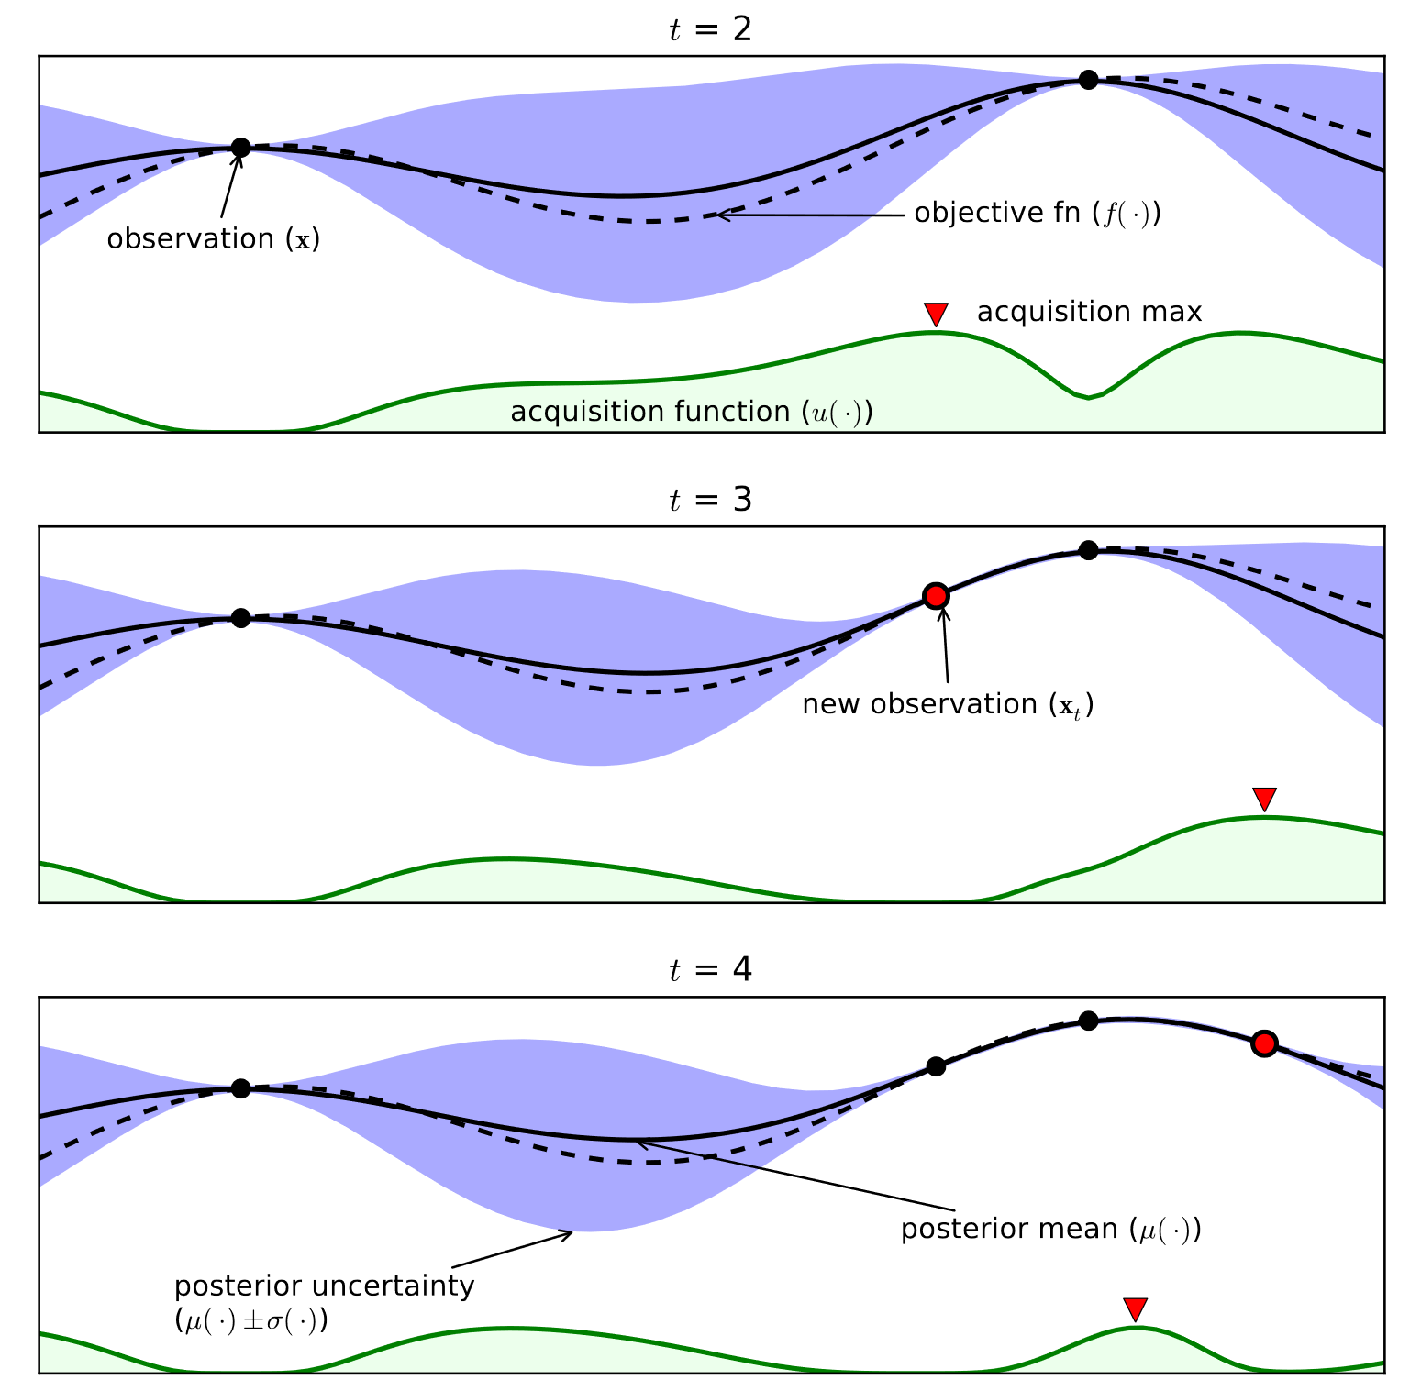
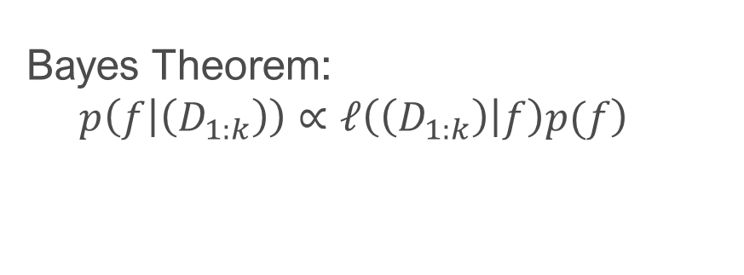
Active Learning: Bayesian Optimization
Likelihood function
Which simulation to conduct?
Training data
Prior belief
Bayes Theorem:
$$\left.p\left(f | \left(D_{1:k}\right)\right)∝𝓁\left(\left(D_{1:k}\right) | f\right)p(f\right)$$
Function to optimize
Expensive to evaluate
Black-box in experiments
Objective
simulation result
How to building posterior model?
Gaussian Process Regression
2

Slide 4
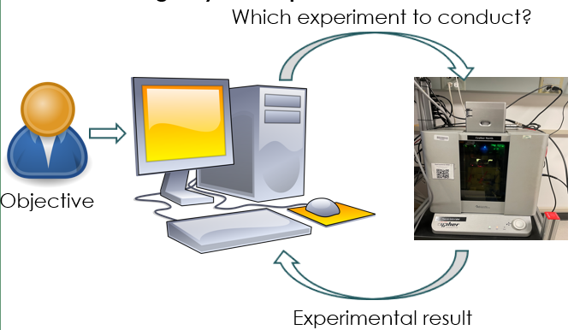
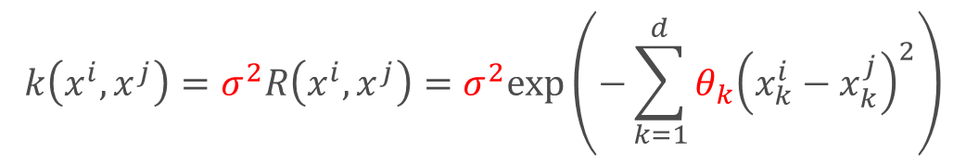
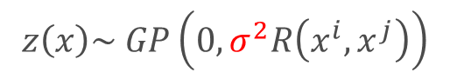
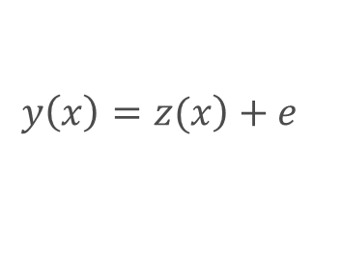
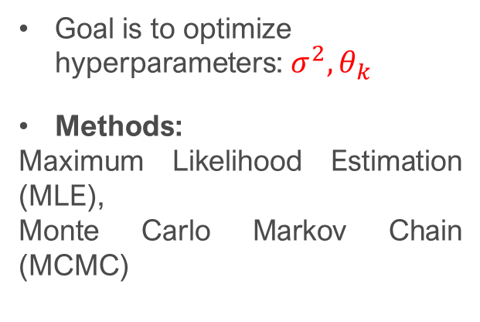
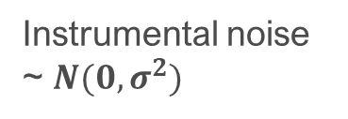
Bayesian Optimization: Prediction Model
Gaussian Process Regression
data
Predicts unexplored region
Provides measure of uncertainty.
Zero mean function
$$\left.y\left(x\right)=z(x\right)+e$$
Goal is to optimize hyperparameters: $σ^{2},θ_{k}$
Methods:
Maximum Likelihood Estimation (MLE),
Monte Carlo Markov Chain (MCMC)
$$z\left(x\right)\sim GP\left(0,σ^{2}R\left(x^{i},x^{j}\right)\right)$$
Instrumental noise ~ $N(0, σ^{2})$
Covariance function
$$k\left(x^{i},x^{j}\right)=σ^{2}R\left(x^{i},x^{j}\right)=σ^{2}exp\left(−\sum_{k=1}^{d}{θ_{k}{\left(x_{k}^{i}−x_{k}^{j}\right)}^{2}}\right)$$
3

Slide 5
Bayesian Optimization: Prediction Model
Gaussian Process Regression
data
Predicts unexplored region
Provides measure of uncertainty.
Marginal Probability Distribution
Kernel matrix
Standard deviation
$$p\left(y\right)\sim N\left(0,C\right)where C=K+σI (Adding noise)$$
$$c\left(x^{i},x^{j}\right)= k\left(x^{i},x^{j}\right)+σ_{ij}$$
4

Slide 6
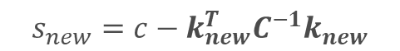
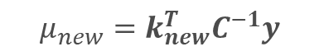
Bayesian Optimization: Prediction Model
Gaussian Process Regression
data
Predicts unexplored region
Provides measure of uncertainty.
Conditional distribution for new observation
$$p\left(y_{new}|y\right)\sim N\left(μ_{new},s_{new}\right)$$
$$μ_{new}=k_{new}^{T}C^{−1}y$$
$$s_{new}=c−k_{new}^{T}C^{−1}k_{new}$$
$k_{new}^{T}$= $[k\left(x^{1},x^{new}\right)$, $k\left(x^{2},x^{new}\right)$,…., $k\left(x^{n},x^{new}\right)$]
$$c=k\left(x^{new},x^{new}\right)+σ$$
5

Slide 7
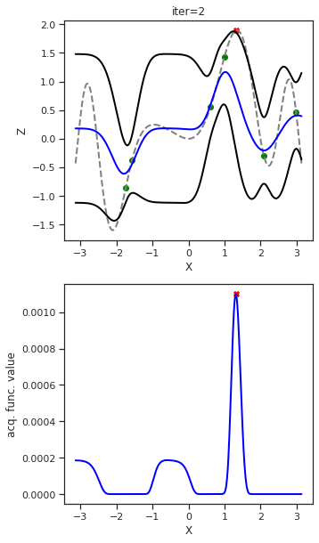
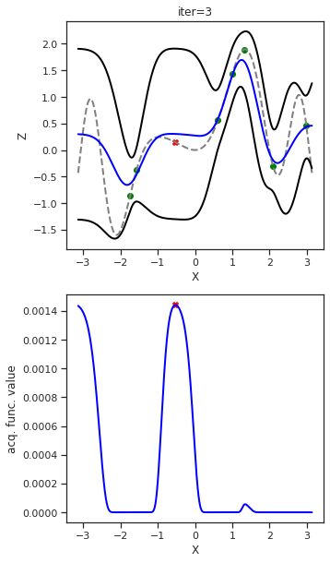
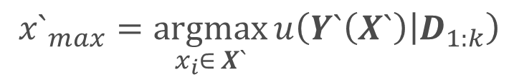
Bayesian Optimization: Acquisition Functions
$${x`}_{max}=\underset{x_{i}∈ X`}{argmax}{u\left(Y`\left(X`\right) | D_{1:k}\right)}$$
Unsampled data
Training data
Next candidate
Acquisition function
Trade-off between exploration and exploitation
Select future experiments
Guidance with alignment to human static objective
GP mean
GP variance
Exploitation
Exploration
6

Slide 8
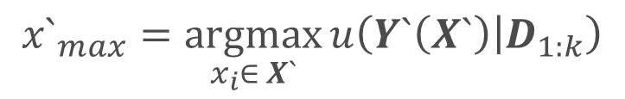
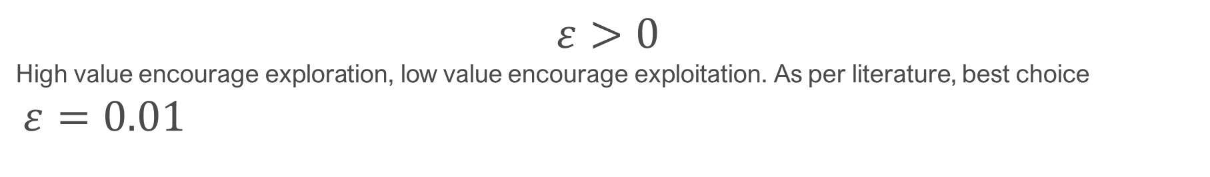
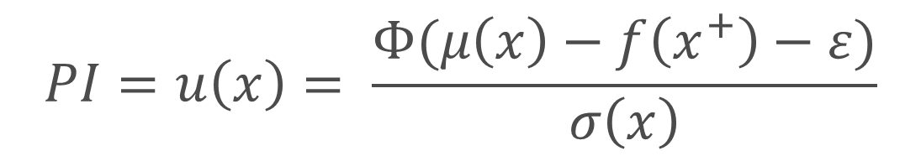
Acquisition Function: Probability of Improvement
$${x`}_{max}=\underset{x_{i}∈ X`}{argmax}{u\left(Y`\left(X`\right) | D_{1:k}\right)}$$
Unsampled data
Training data
Probability of Improvement (PI): $P(f\left(x\right)≥f\left(x^{+}\right)+ ε)$
Best solution (Current)
CDF
Trade-off factor
$$PI=u\left(x\right)= \frac{Φ(μ\left(x\right)−f\left(x^{+}\right)−ε)}{σ\left(x\right)}$$
$$ε>0$$
High value encourage exploration, low value encourage exploitation. As per literature, best choice
$ε=0.01$
7

Slide 9
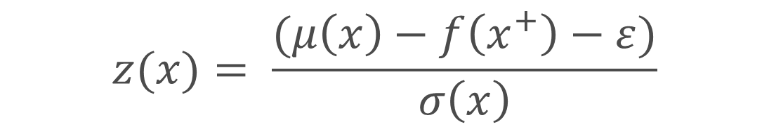
Acquisition Function: Expected Improvement
$${x`}_{max}=\underset{x_{i}∈ X`}{argmax}{u\left(Y`\left(X`\right) | D_{1:k}\right)}$$
Unsampled data
Training data
Expected Improvement(EI): $I\left(x\right)=max⁡\{0, (f\left(x\right)−f\left(x^{+}\right)−ε\}$
CDF
pdf
$EI= u(x)=$ $\left(μ\left(x\right)−f\left(x^{+}\right)−ε\right)Φ\left(z\right)+ σ(x)φ(z)$
$$z(x)= \frac{(μ\left(x\right)−f\left(x^{+}\right)−ε)}{σ\left(x\right)}$$
8

Slide 10
Acquisition Function: Confidence Interval
$${x`}_{max}=\underset{x_{i}∈ X`}{argmax}{u\left(Y`\left(X`\right) | D_{1:k}\right)}$$
Unsampled data
Training data
Upper Confidence Interval (UCB) : For Maximization
$UCB= u(x)=$ $\left(μ\left(x\right)+βσ(x)\right)$
Lower Confidence Interval (UCB) : For Minimization
Trade-off factor
$UCB= u(x)=$ $\left(μ\left(x\right)−βσ(x)\right)$
9

Slide 11
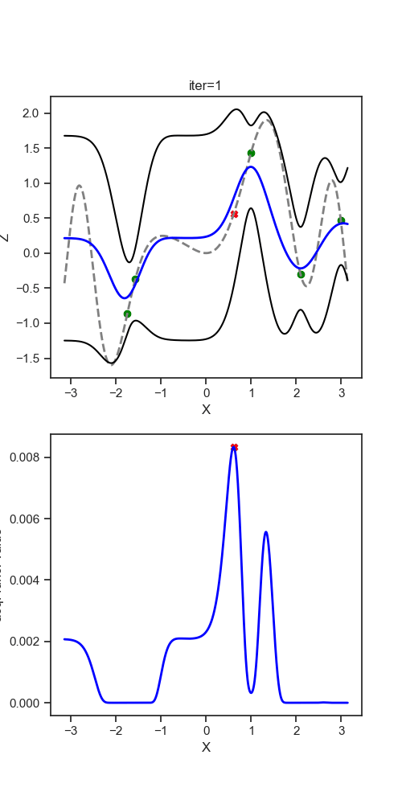
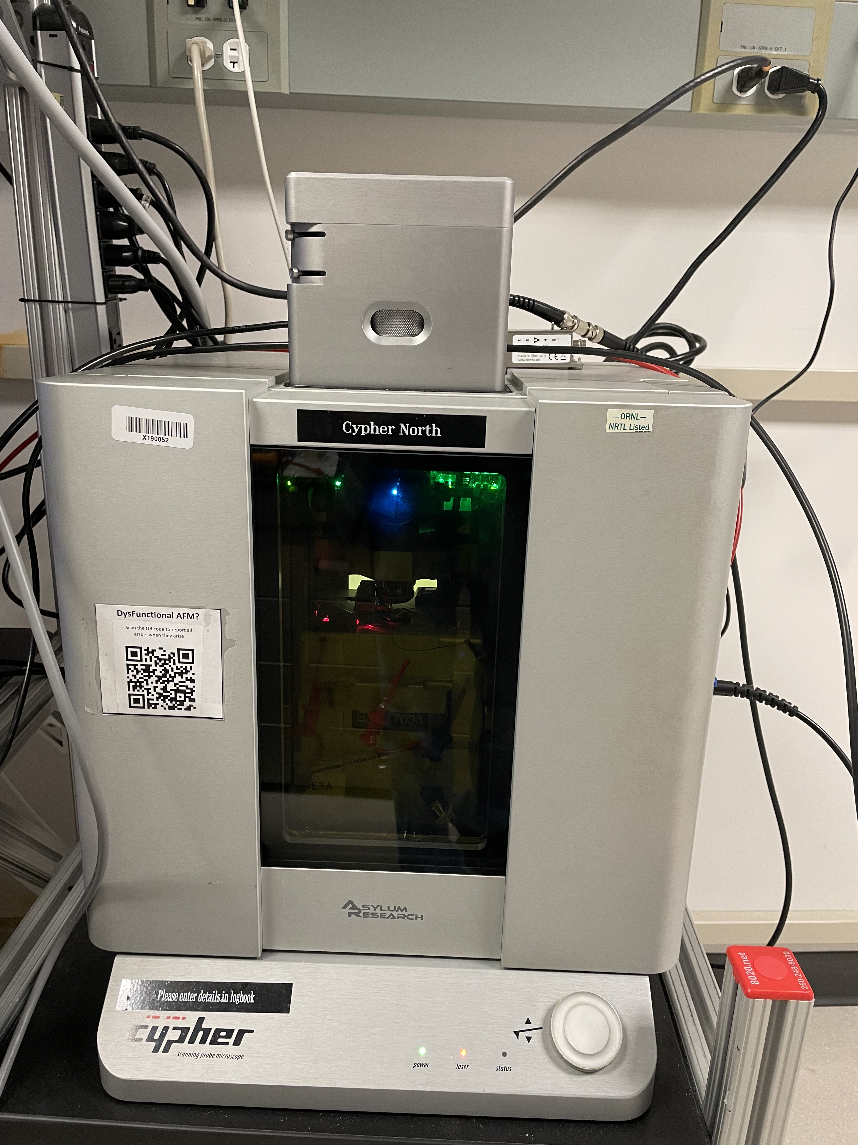
Active Learning: Bayesian Optimization
Region of Interest
Prediction Model
Objective
(Maximize)
Future sample selection
10

Slide 12
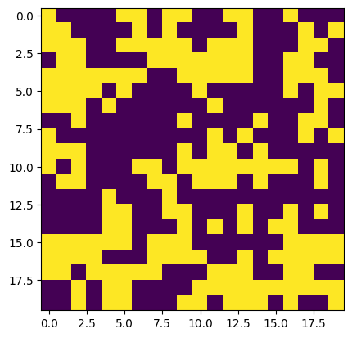
Time for some Hands-on:
Numerical Problems
Ising model Problem with 20 x 20 Lattice Size
11

Slide 13
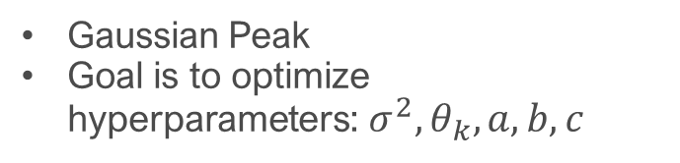
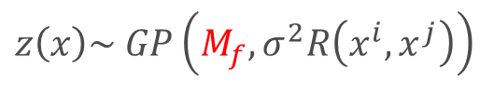
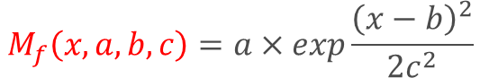
Active Learning: Structured Bayesian Optimization
Maxim A Ziatdinov et al 2022 Mach. Learn.: Sci. Technol. 3 015003
Gaussian Process Regression
data
Predicts unexplored region
Provides measure of uncertainty.
Physics knowledge injection
Mean function model
$$\left.y\left(x\right)=z(x\right)+e$$
$$z\left(x\right)\sim GP\left(M_{f},σ^{2}R\left(x^{i},x^{j}\right)\right)$$
Gaussian Peak
Goal is to optimize hyperparameters: $σ^{2},θ_{k}, a, b, c$
$$M_{f}\left(x, a,b,c\right)=a×exp\frac{{\left(x−b\right)}^{2}}{2c^{2}}$$
$p\left(a\right)=halfN\left(0.5\right)$, $p\left(b\right)=halfN\left(1.17\right),p\left(c\right)=halfN(2)$
12

Slide 14
Time for some Hands-on:
Let's try if we can get better convergence with sGP
13

Slide 15
Concluding Statement
60x60 Ising model
Classical Physics model
Objective
To learn phase transition at the ferromagnetic region over exploring 60x60 lattice size
Time for each simulation is ~ 8 mins
Model of Interest: Square Model
Objective
We want to explore 60 x60 or 120x120 lattice size model.
Upcoming Talk:
Combining physics with multi-fidelity computation for improved Bayesian active learning based exploration over lattice Hamiltonian system
Thursday, 7th Mar (4:00 pm -4:12 pm)
Session: Statistical Physics Meets Machine Learning III
Room: 101I
Motivation Question
Is Still BO or sBO enough?
14

